Slide 1
C-Mod GPI shots for XGC-1 Comparison
sz 9/15/17
• Found in GPI camera database as shots closest to 1100223012
• Several other shots of 1110120 and 1110121 are very similar
• Analysis code at /zweben/phantom/phantom_XGC_15.pro

Slide 2
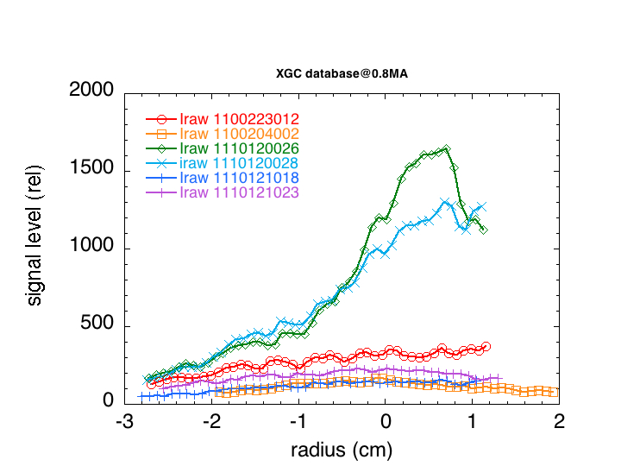
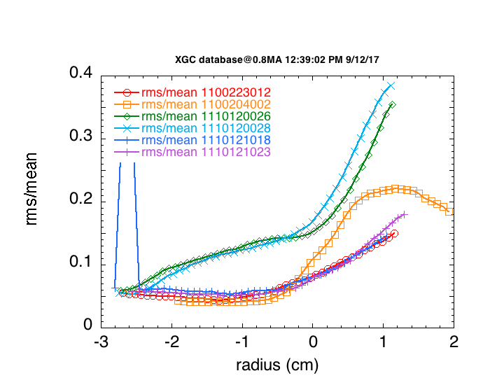
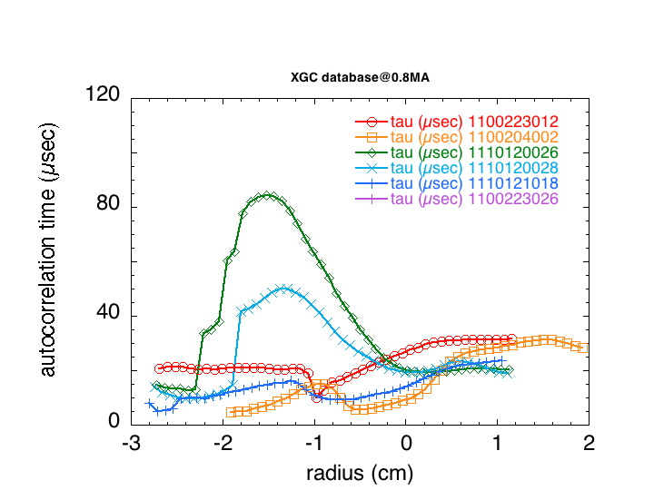
Turbulence Analysis Results 1
• analysis done in columns #10-55,
converted to radius using sz’s
usual GPI alignment algorithm
• results in KaleidaGraph database
“XGC database 0.8 MA.qda”
• movies for these six 0.8 MA shots
http://w3.pppl.gov/~szweben/CMod2017/CMod2017.html
signal
tau
rms

Slide 3
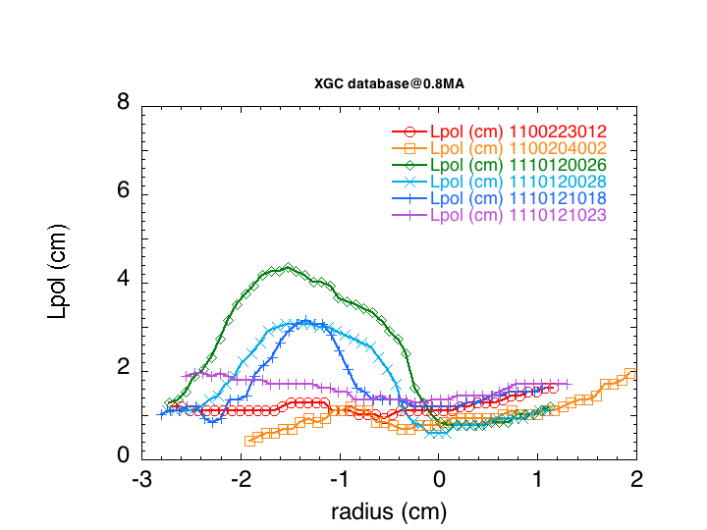
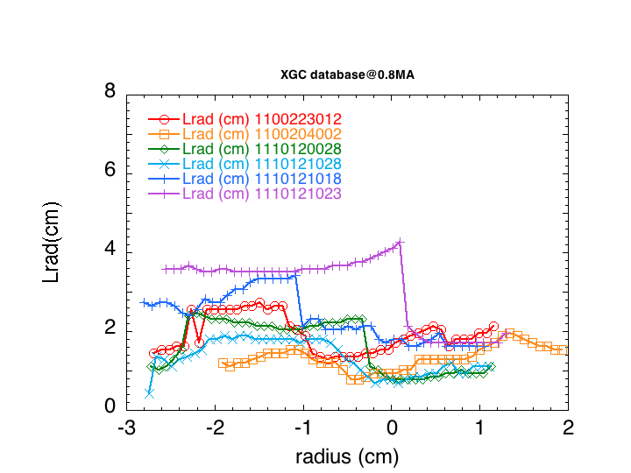
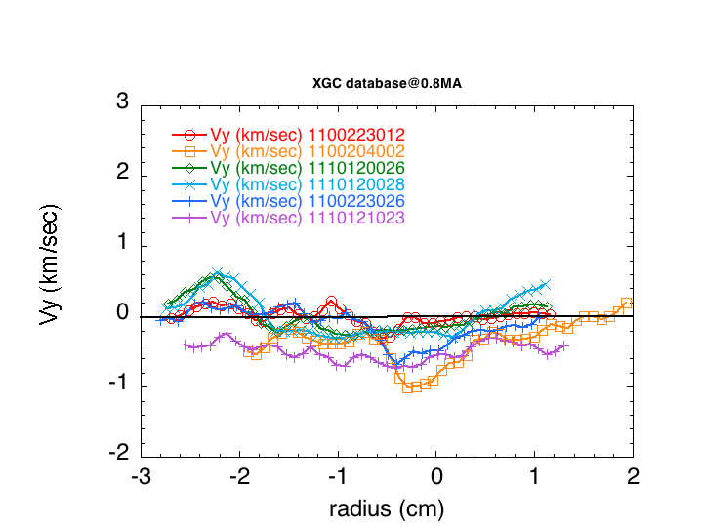
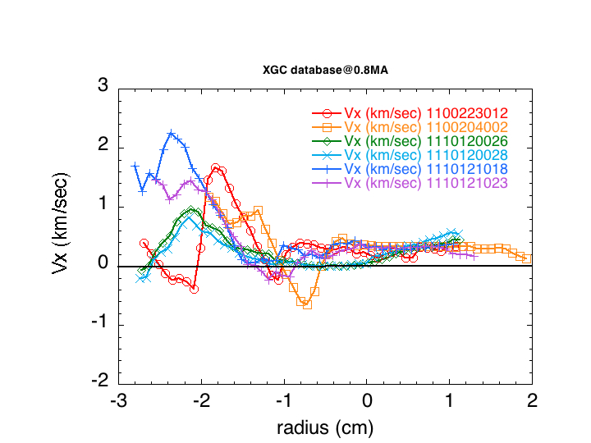
Turbulence Analysis Results 2
Lpol
Lrad
Vpol
Vrad

Slide 4
Tentative Summary for 0.8 MA Shots
• Average results within ±1 cm of separatrix for these shots
rms/mean = 0.13±0.07
tau-auto = 21±9 µsec
Lpol = 1.3±0.6 cm
Lrad = 1.7±0.8 cm
Vpol = -0.26±0.27 km/sec
Vrad = 0.22±0.19 km/sec
• Some results need further checking before finalization
- separatrix location with latest JT registration
- long tau inside separatrix for 1110120 shots
- high Lpol inside separatrix for 1110120 shots
- sudden increase in Lrad for 1110121 shots
• Should put these shots into context of larger database

