Slide 1
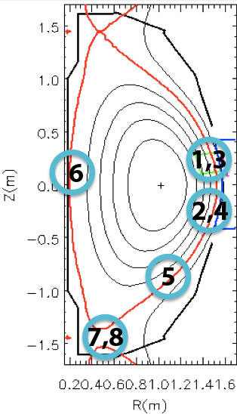
Potential GPI Upgrades for 5-year plan
Bay B:
20° above midplane
 20° below midplane
(2 views along common field line)
Technical requirements:
Modify “elbow” to “tee”, using same re-entrant port
(move lower manifold down?)
(add shutter?)

Slide 2
Potential GPI Upgrades for 5-year plan
Between Bays I & J:
 20° above midplane
 20° above midplane
~40° below midplane
(3 views along common field line)
Technical requirements:
Similar to Bay B installation
(re-entrant “tee” viewport
with shutters).
Requires 3x gas manifolds

Slide 3
Potential GPI Upgrades for 5-year plan
Inner Wall:
Center-stack puffer
Technical requirements:
Uses existing viewport on Bay B (separate from the re-entrant port described before)
Uses existing inner-wall puffer installed for NSTX-U fuelling

Slide 4
Potential GPI Upgrades for 5-year plan
Divertor (tangential view):
Divertor puffer
Technical requirements:
Uses existing viewport at Bay F
Uses existing puffer in the divertor region.

Slide 5
Potential GPI Upgrades for 5-year plan
Divertor (top-down view):
 Divertor puffer
Technical requirements:
Uses existing viewport at top of vessel at Bay E
Uses existing puffer in the divertor region.

