Slide 1
Investigating small-scale edge turbulence with GPI
Noah Mandell, Stewart Zweben, Walter Guttenfelder, Yang Ren, Steve Sabbagh
NSTX T&T Forum 2015
2/25/2015

Slide 2
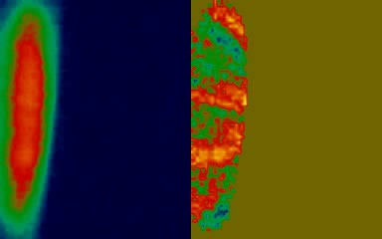
Motivation & Method
2010 GPI data included shots that showed small-scale (sub-cm) structure → consistent with ETG turbulence, “streamers”
Zoom optics upgrade will allow 2-3x zoom to enhance spatial resolution of optics so that ~2-3mm structure can be resolved
Other upgrades to fiber bundle, etc will allow better signal-to-noise ratio, possibly faster frame rate for movies
There will be some k-spectrum here
Notes:
current GPI region: 25x30 cm → zoom region 12x15 cm. current frame rate: 400,000 fps, could double.

Slide 3
Experiment Goals
Measure fluctuation spectra of edge turbulence from GPI movies
Examine how edge turbulence changes with ∇T_{e}, ∇n_{e} near separatrix
Compare with theory (Guttenfelder) and other diagnostics (e.g. high-k scattering, Ren) to assess whether observed fluctuations are characteristic of ETG turbulence or other theorized modes
Determine role of turbulence in stiff T_{e} profiles near separatrix (as suggested by Canik et al, 2011)

Slide 4
Plasma Conditions
Require scans of B_{T} & I_{P} to align B_{z}/B_{Φ} with GPI view to maximize optical resolution (Sabbagh)
H-mode, boron PFC required to get large ∇T_{e} near separatrix for ETG study
Can piggy-back on other XPs for additional data as allowed

